Slide 1
A Taste of Fisheries Science #4: A Population Dynamics Prelude
Dr. Heather Bowlby and Dr. David Keith
Fisheries and Oceans, Canada

Slide 2
Quick reminder of what we are trying to do
What are the objectives of traditional Fisheries Science?
In the area you want to go fishing, how many fish are there?
Should be we happy or worried about this number?
How many can you sustainably (optimally) remove via a fishery?
How do we achieve this objective?
In theory, it’s pretty simple…
Go out and count your species in the area of interest (Survey – Fishery Independent data).
Go out and count how many fish were removed by the fishery (Fishery Dependent data)
Plug (1) and (2) into a (sometimes) fancy statistical model (Stock Assessment Model).
Figure out what a safe number of fish to harvest is (Precautionary Approach – Reference Points, etc)
Notes:
Four lecture topics are identified by red boxes
- People is in bold because there are direct implications of the science on the people that it impacts.

Slide 3
Step 3a: A Population Dynamics Prelude
An exceptionally brief introduction
Notes:
Discussion with the group.

Slide 4
Populations Dynamics Lingo
Exponential Growth
Deterministic
Demographics
Harvesting
Population viability analysis
Mortality
Stochastic
Quota
Population
Fecundity
Carrying Capacity
Density Dependence
Logistic growth
Projection matrix
Density Independence
Leslie Population Models
Intrinsic rate of growth
Notes:
Why is this critical for stock assessment? I contend that unlike ecology, the terminology used in fisheries science has specific definitions and these matter when trying to assess a stock. For example:
Is a stock the same as a population? The answer to this will tell you if emigration and immigration can be ignored in your assessment model.
Does a cohort describe biomass?
Is catch composition the same as age structure? No – the catch composition depends on the age structure, but is modified by selectivity
How is F related to U; how is S related to M? Fishing mortality and exploitation are not synonymous and we will tell you why.

Slide 5
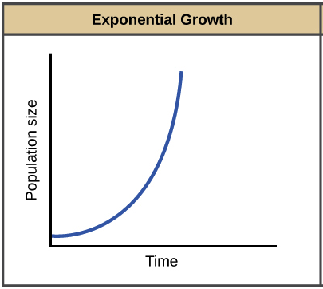
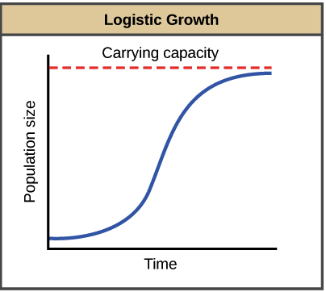
Prelude to Stock Assessment
We need to lay a bit of mathematical background
Stock Assessment models often are generalizations of ecological population dynamics
Often fisheries scientists and ecologists do almost the exact same thing
But for historical reasons they have very different terminology
Schaefer Model
Unfished biomass
Spawning Stock Biomass
Notes:
Four lecture topics are identified by red boxes
- People is in bold because there are direct implications of the science on the people that it impacts.

Slide 6
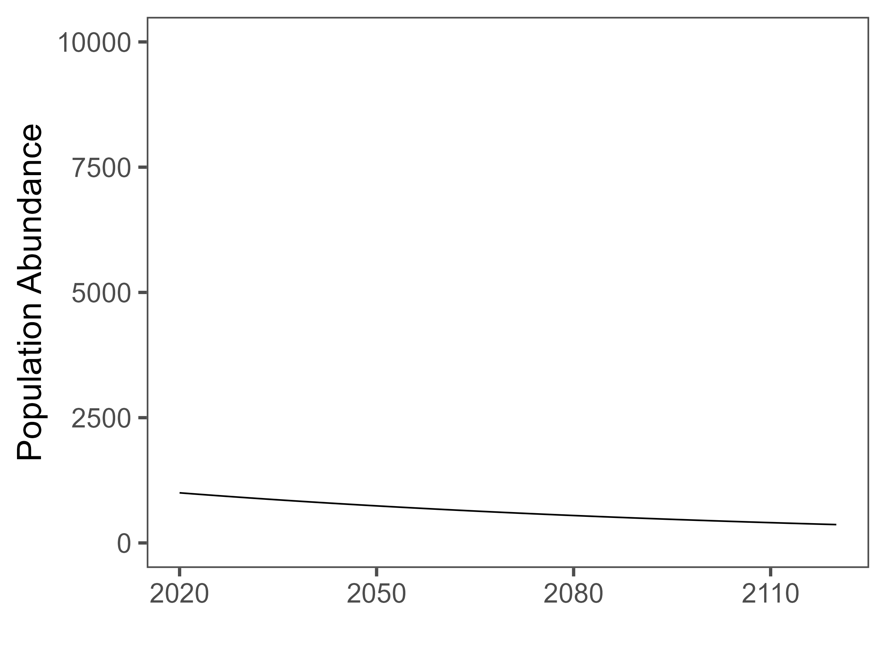
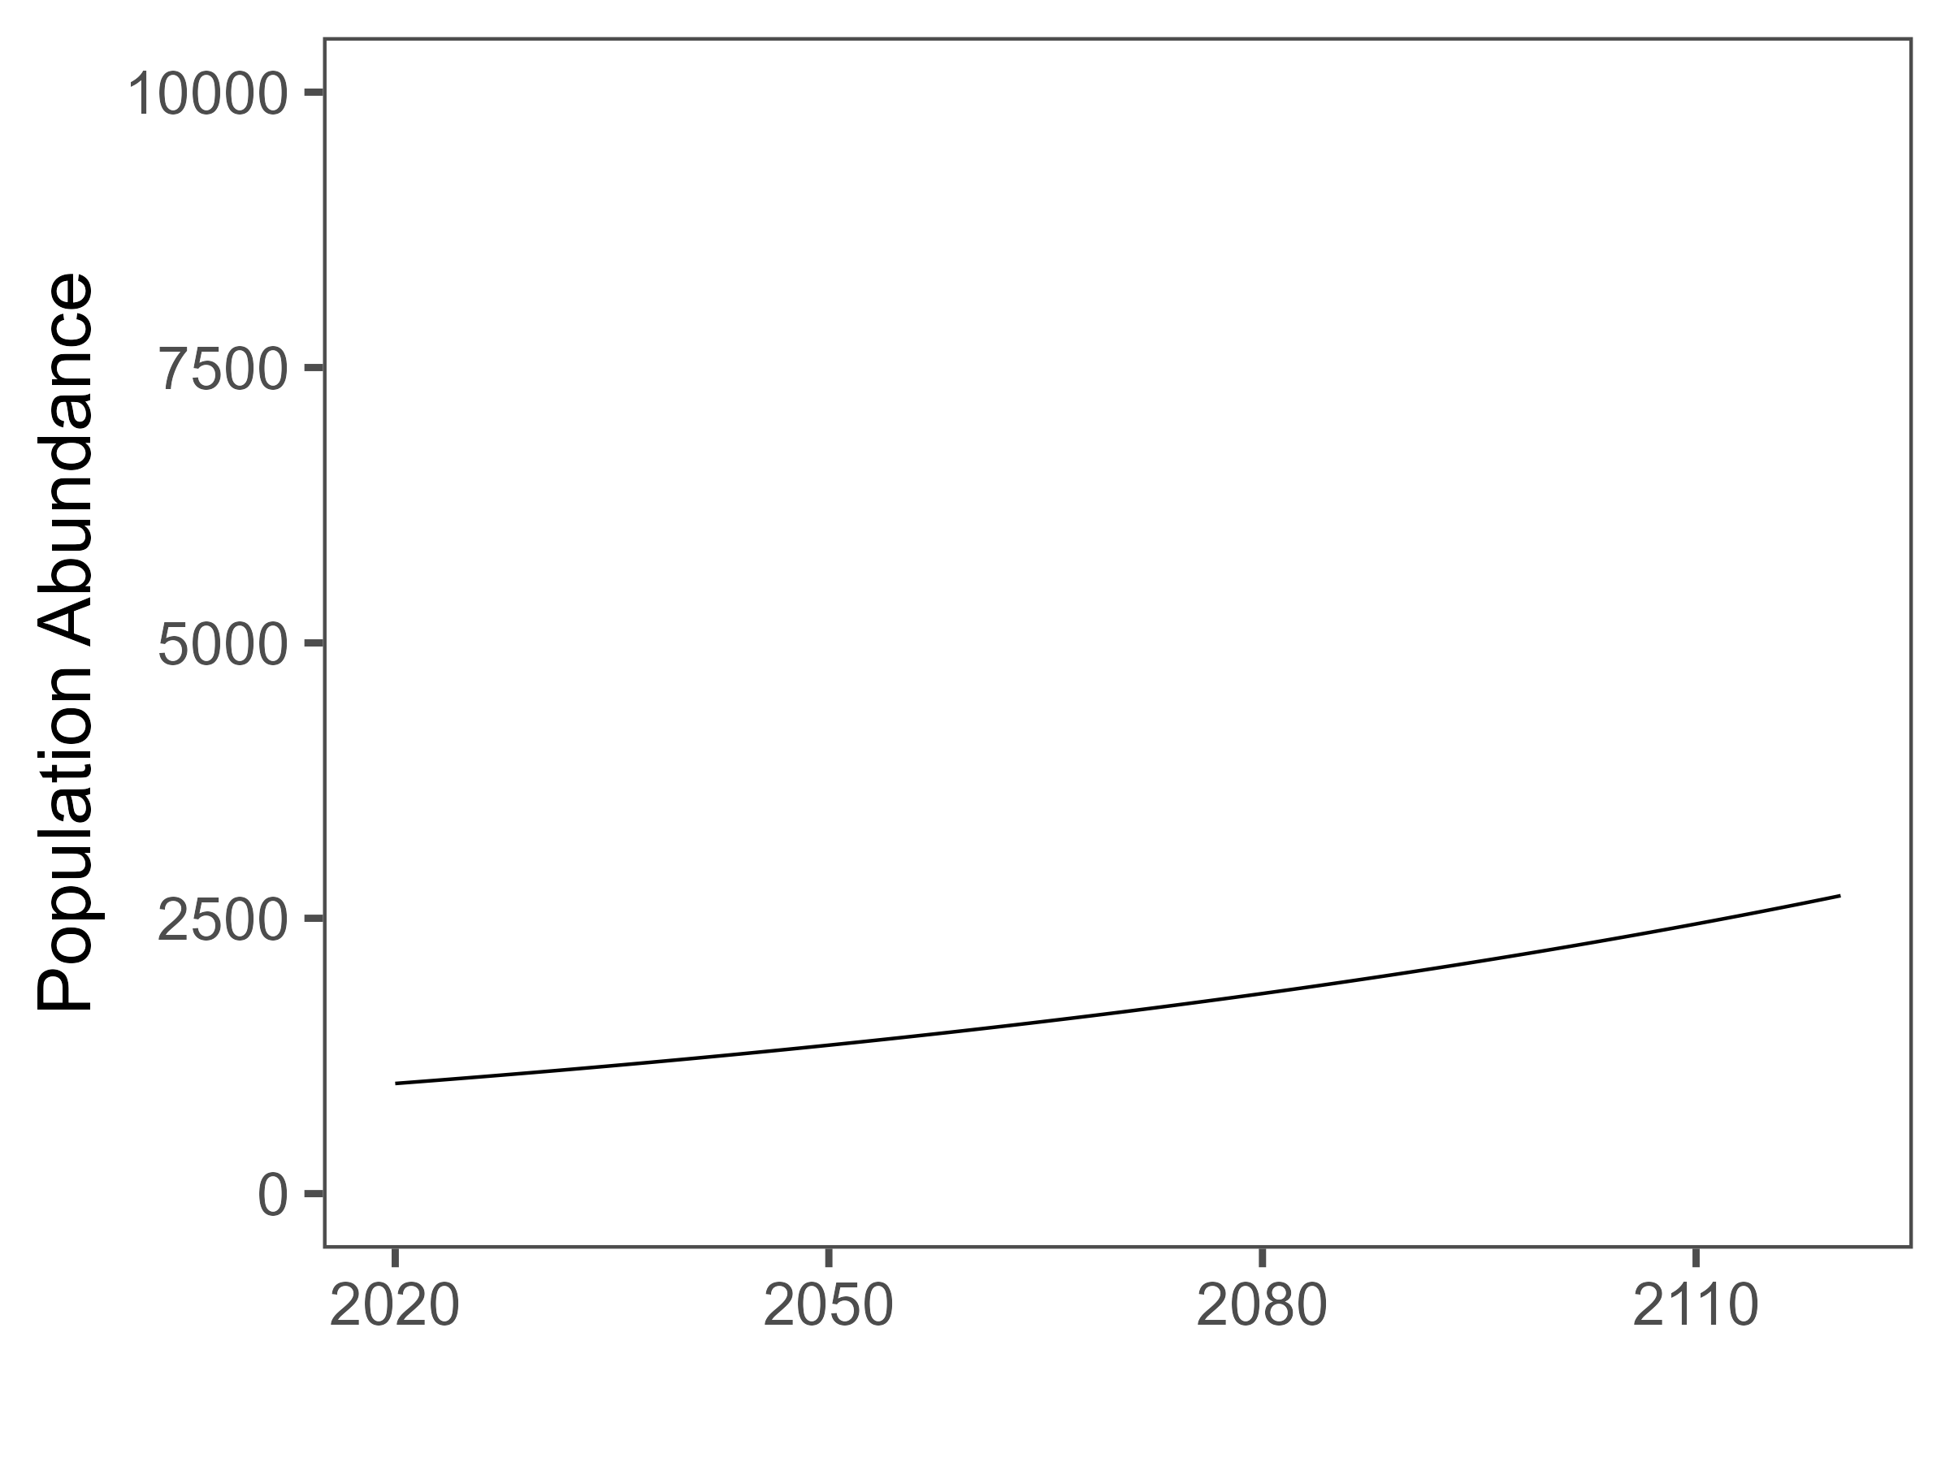
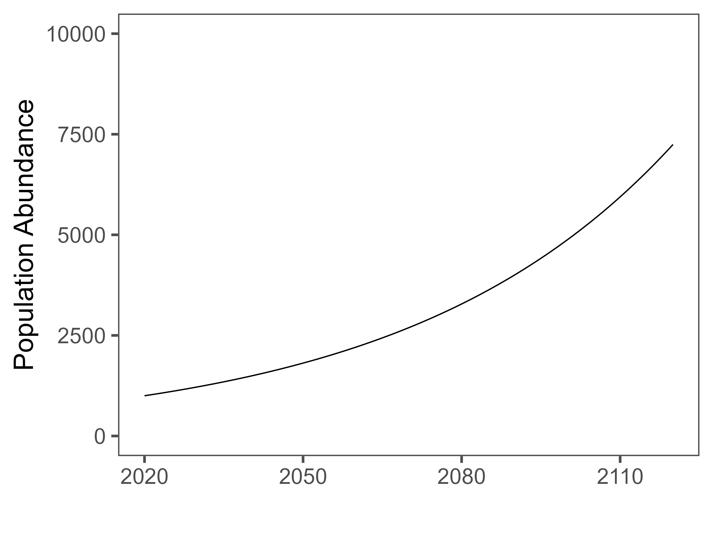
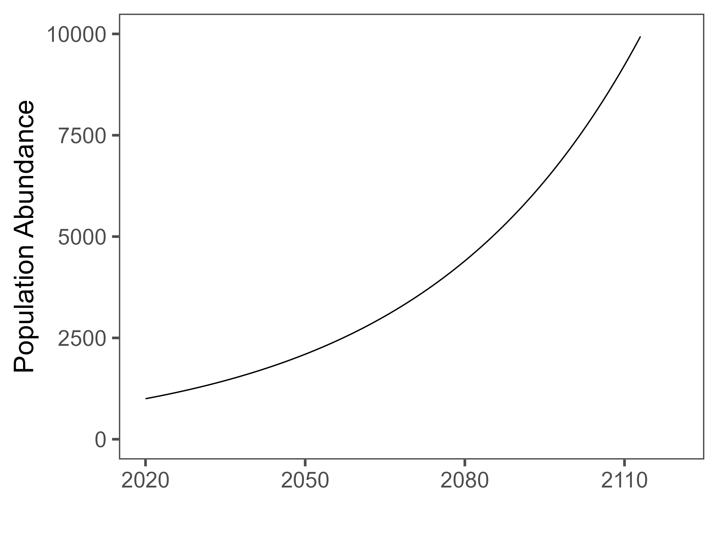

The Exponential Model
The most basic concept in population dynamics
Many of the models build off the concept of exponential growth
r controls the rate of growth of the population
What is r?
$$N_{t+1}=rN_{t}+N_{t}$$
Notes:
Four lecture topics are identified by red boxes
- People is in bold because there are direct implications of the science on the people that it impacts.

Slide 7

The Exponential Model
This r is the intrinsic rate of growth
Remember r… well it’s kinda important!
At it’s most basic it is a measure of Birth rate – Death rate
If r = 0 then Birth rate = Death rate
If r < 0 then Birth rate < Death rate
If r > 0 then Birth rate > Death rate
$$\frac{N_{t+1 }−N_{t}}{N_{t}}=r$$
Notes:
Four lecture topics are identified by red boxes
- People is in bold because there are direct implications of the science on the people that it impacts.

Slide 8
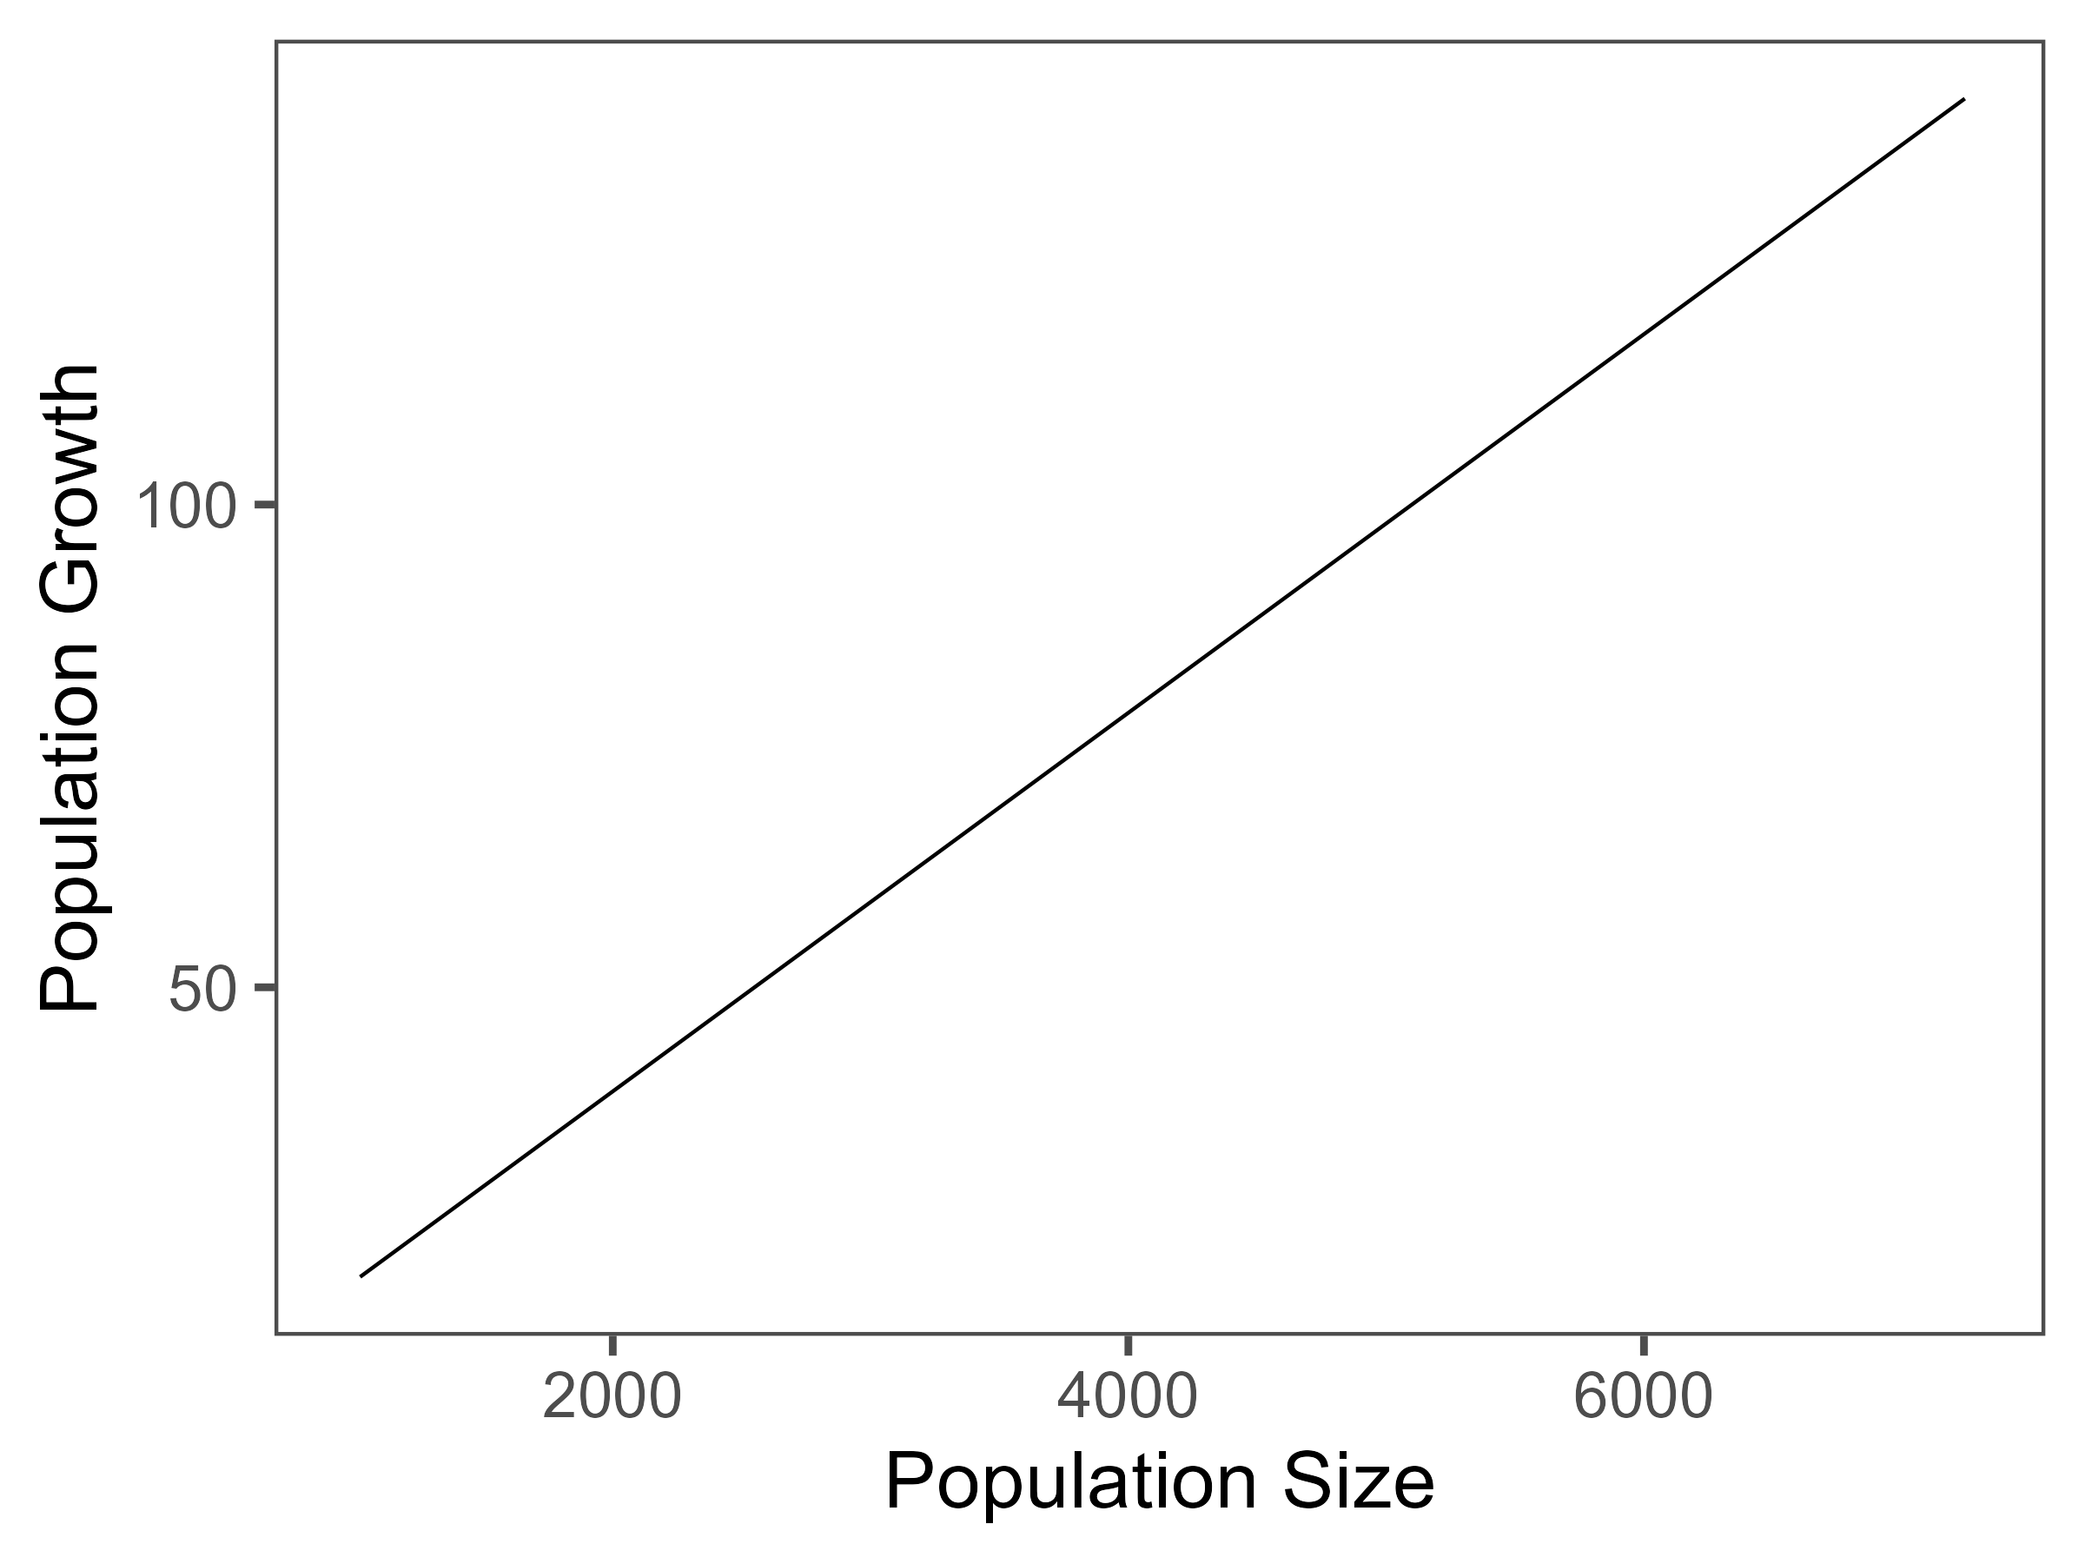
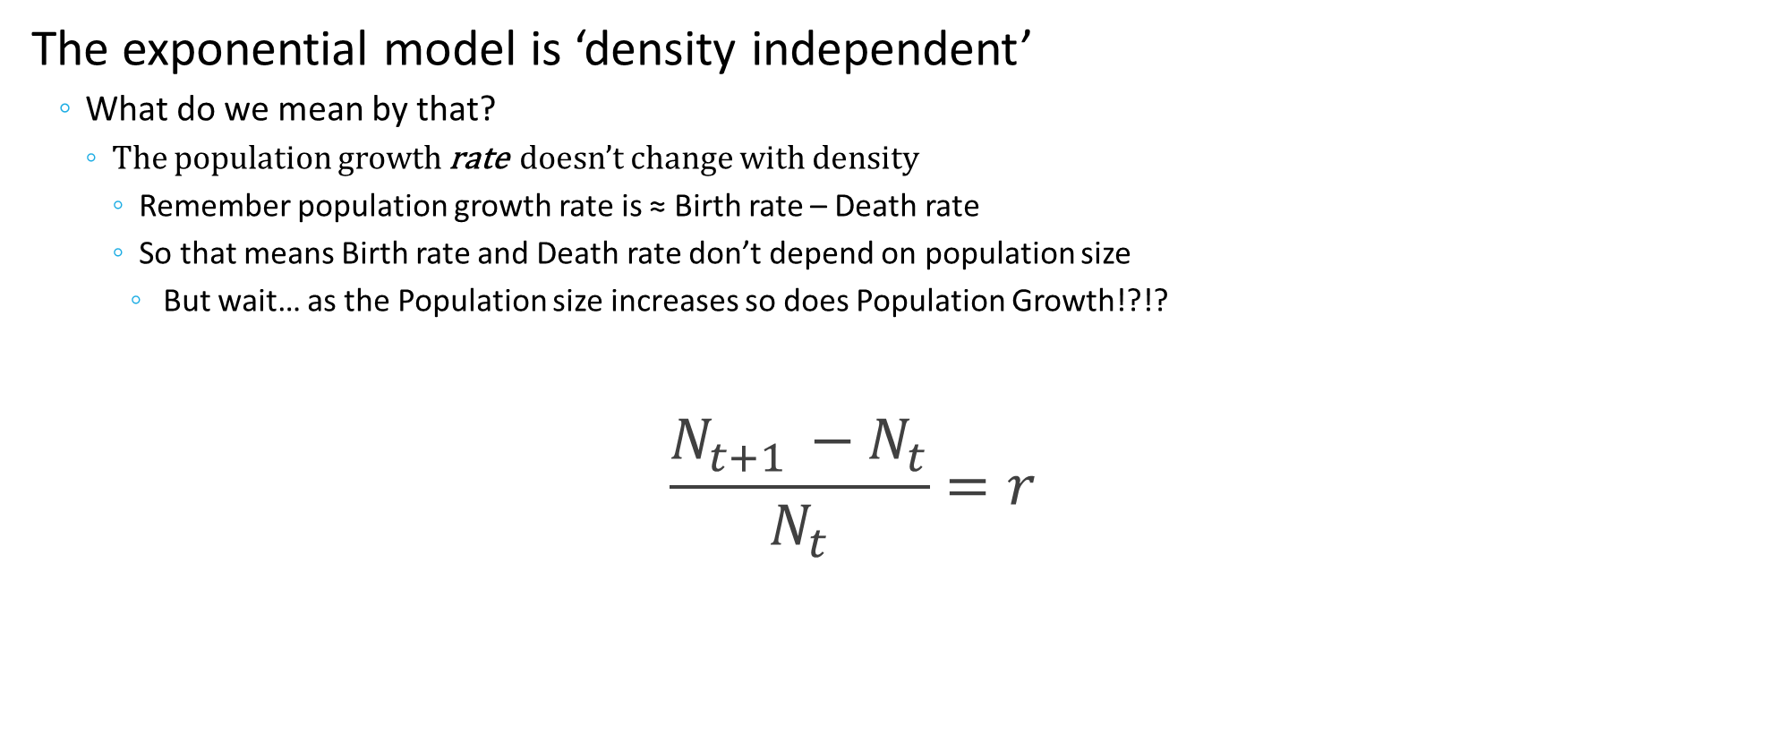
The Exponential Model
The exponential model is ‘density independent’
What do we mean by that?
The population growth rate doesn’t change with density
Remember population growth rate is ≈ Birth rate – Death rate
So that means Birth rate and Death rate don’t depend on population size
But wait… as the Population size increases so does Population Growth!?!?
$$\frac{N_{t+1 }−N_{t}}{N_{t}}=r$$
Notes:
Four lecture topics are identified by red boxes
- People is in bold because there are direct implications of the science on the people that it impacts.

Slide 9
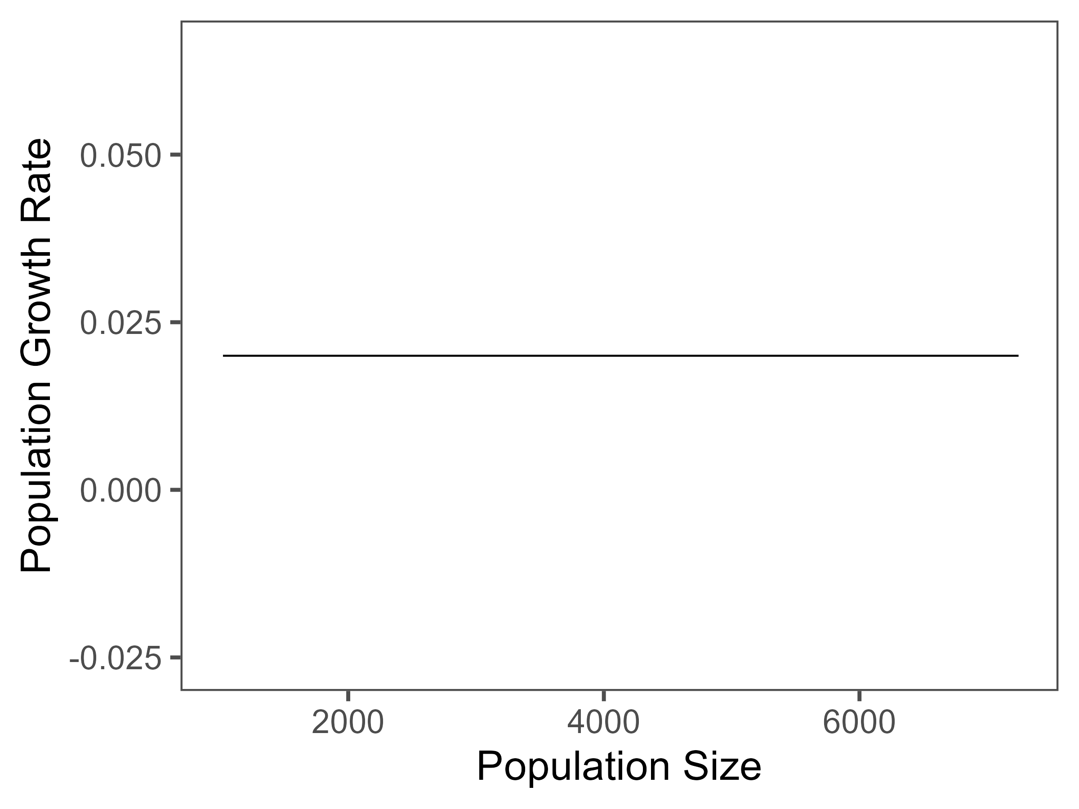

The Exponential Model
The exponential model is ‘density independent’
What do we mean by that?
The population growth rate doesn’t change with density
Remember population growth rate is ≈ Birth rate – Death rate
So that means Birth rate and Death rate don’t depend on population size
But wait… as the Population size increases so does Population Growth!?!?
IT IS THE RATE OF GROWTH THAT DOESN’T CHANGE
In this example the population grows at 2% a year no matter what!
$$\frac{N_{t+1 }−N_{t}}{N_{t}}=r$$
Notes:
Four lecture topics are identified by red boxes
- People is in bold because there are direct implications of the science on the people that it impacts.

Slide 10
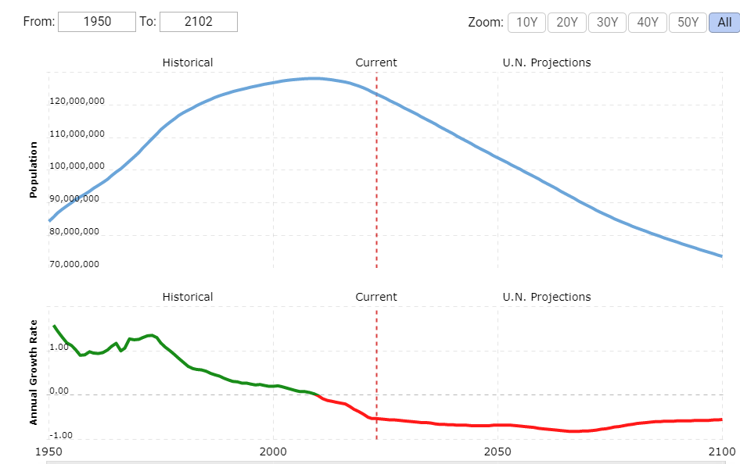
A Demographic Moment
Japanese demographics example
Declining population growth rate
But population kept growing (until around 2000)
Population increased and growth rate declined
This is negative density dependence
Population grows, rate declines (or vice versa)
Currently, the population is declining
The population growth rate is still declining
This is positive density dependence
Positive density dependence is often ‘unstable’
Notes:
Four lecture topics are identified by red boxes
- People is in bold because there are direct implications of the science on the people that it impacts.

Slide 11

The Logistic Model
A natural extension of the exponential model
$$N_{t+1}=rN_{t}\left(1−\frac{N_{t}}{K}\right)+N_{t}$$
Notes:
Four lecture topics are identified by red boxes
- People is in bold because there are direct implications of the science on the people that it impacts.

Slide 12
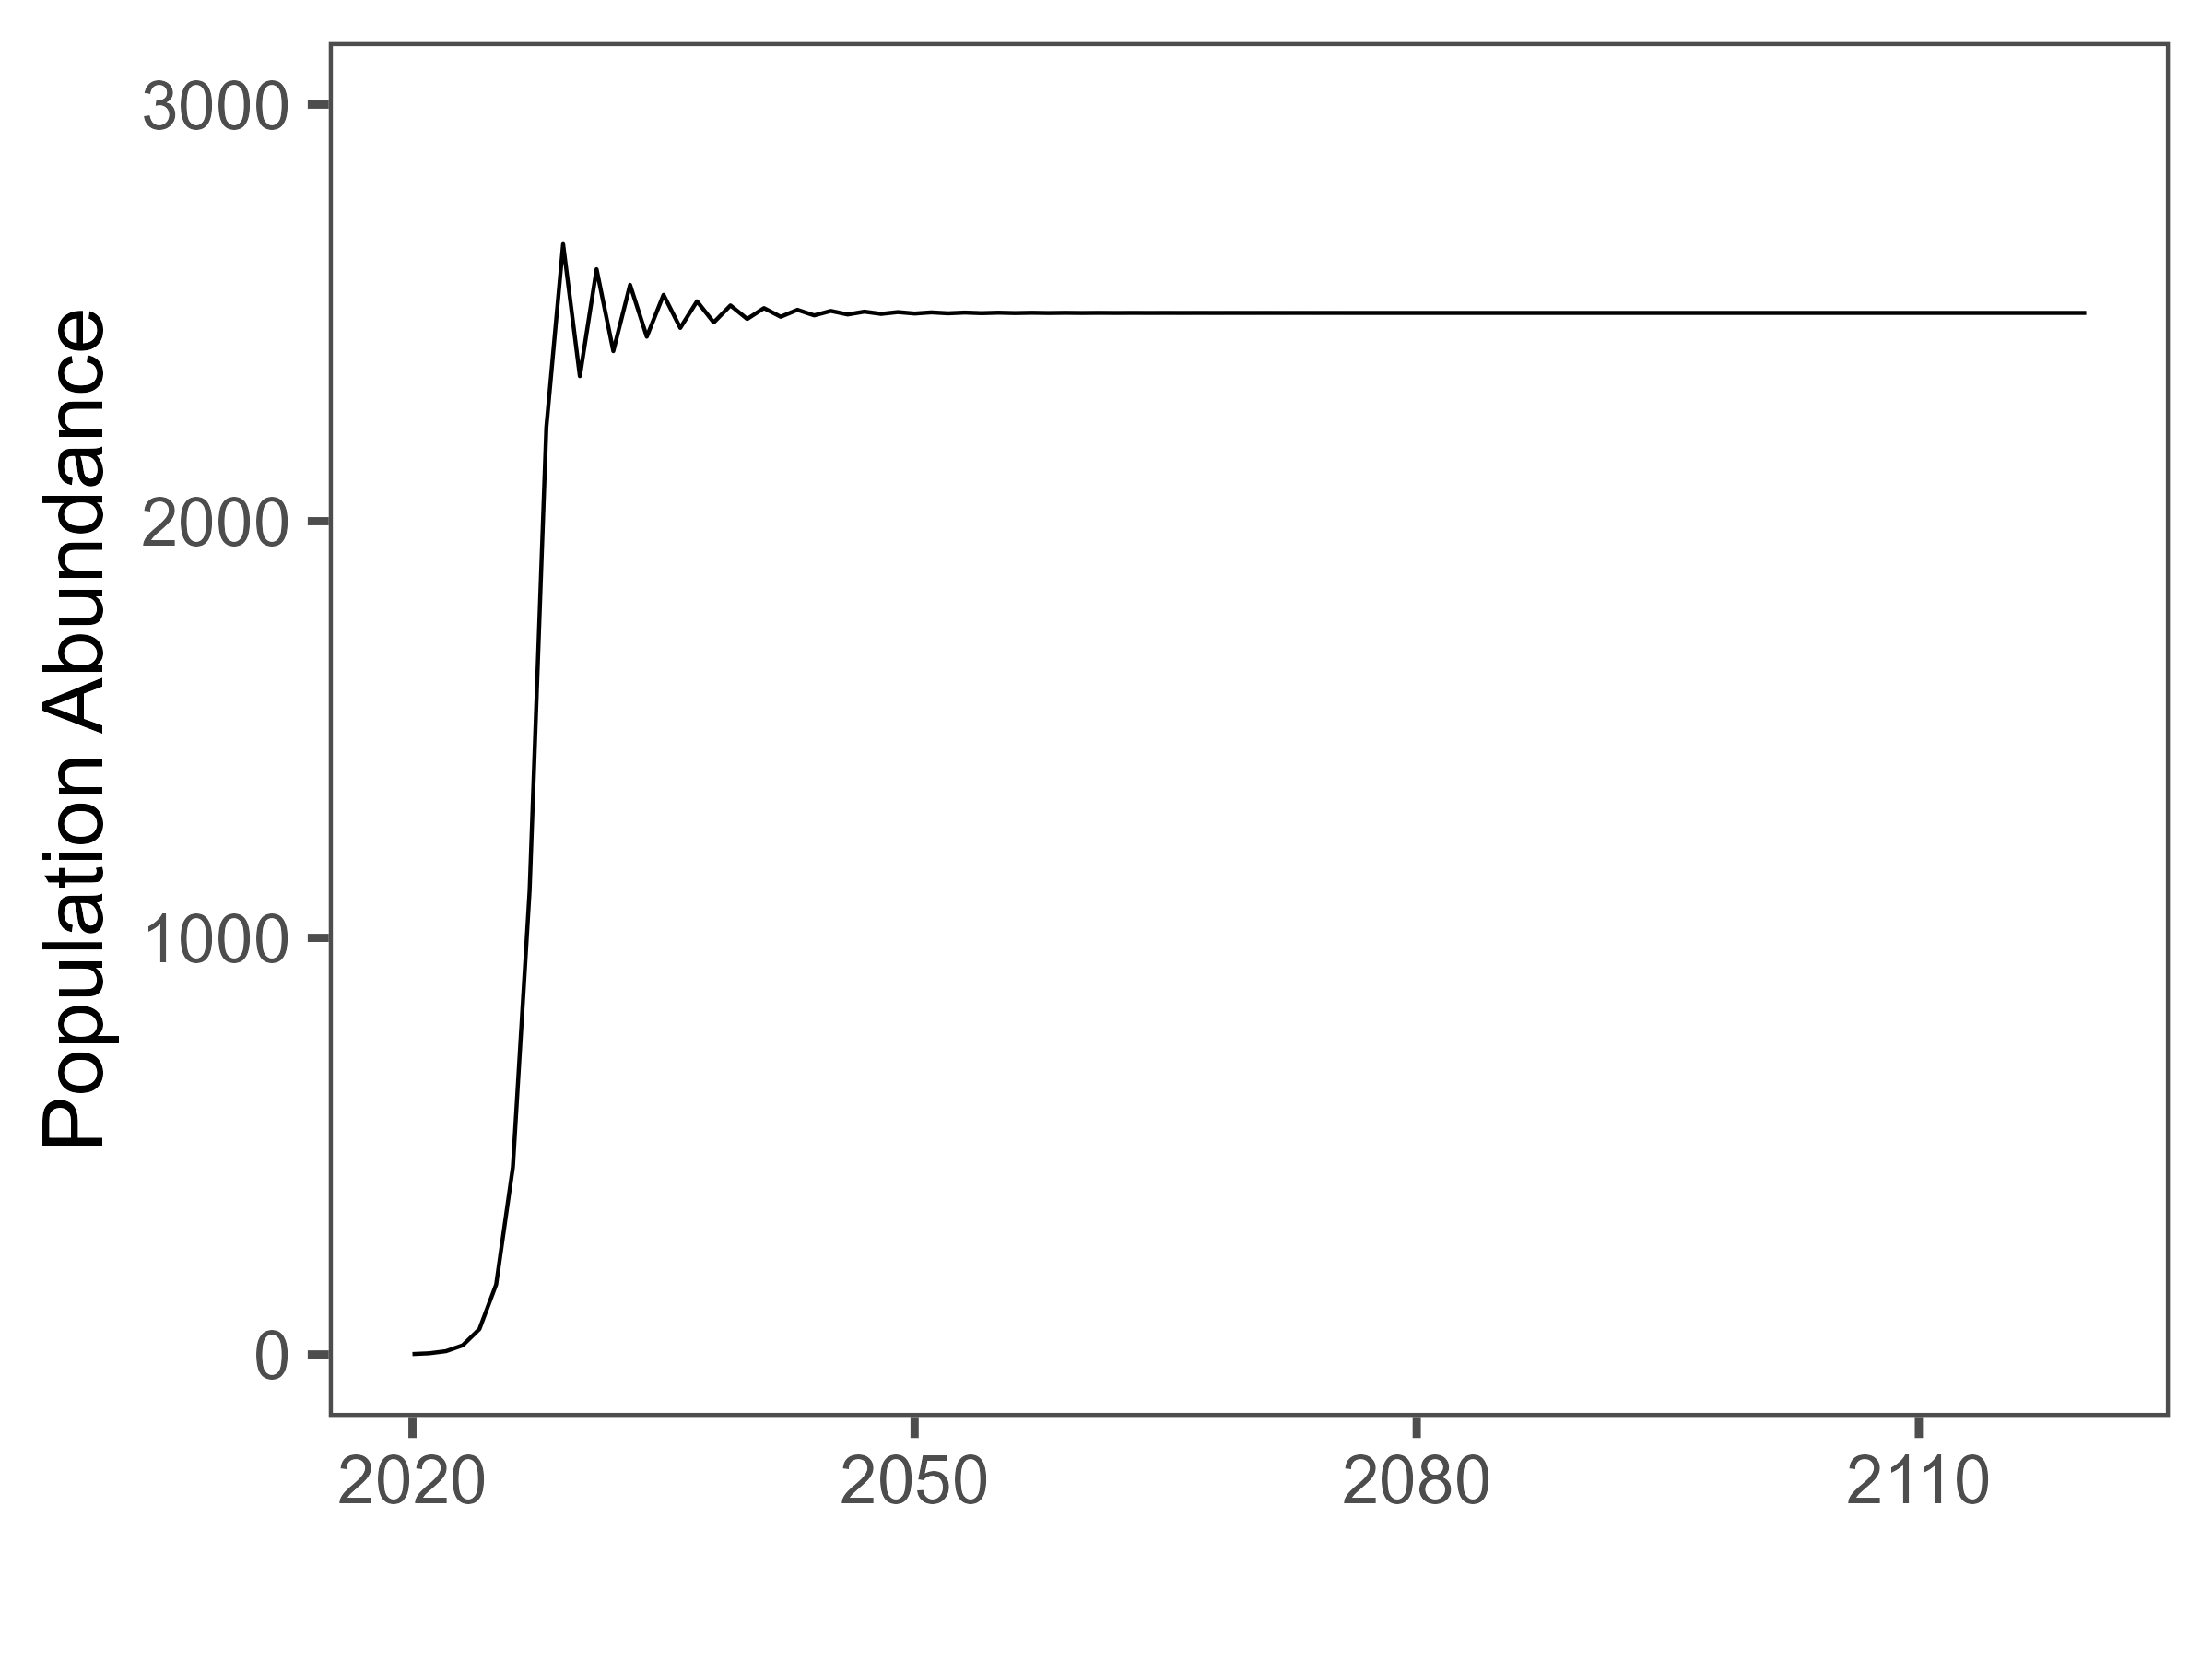
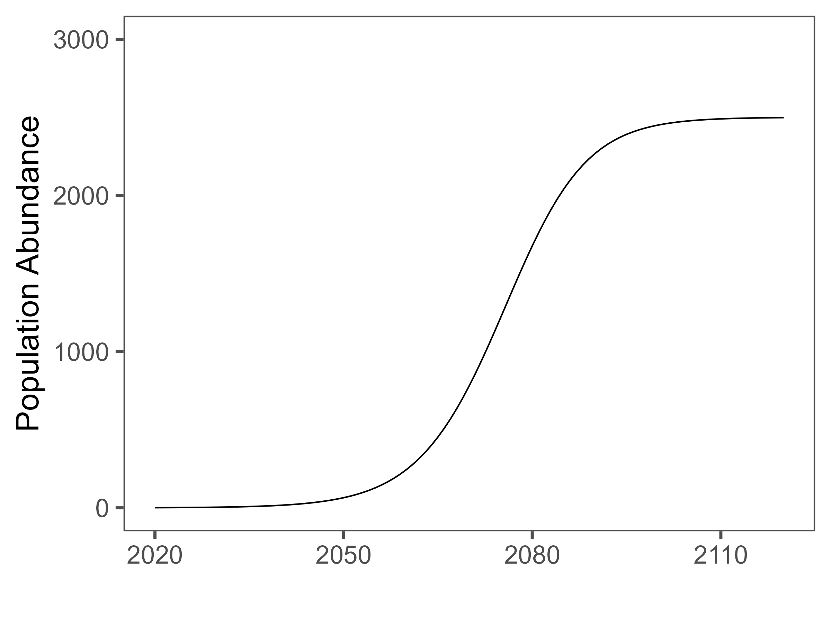
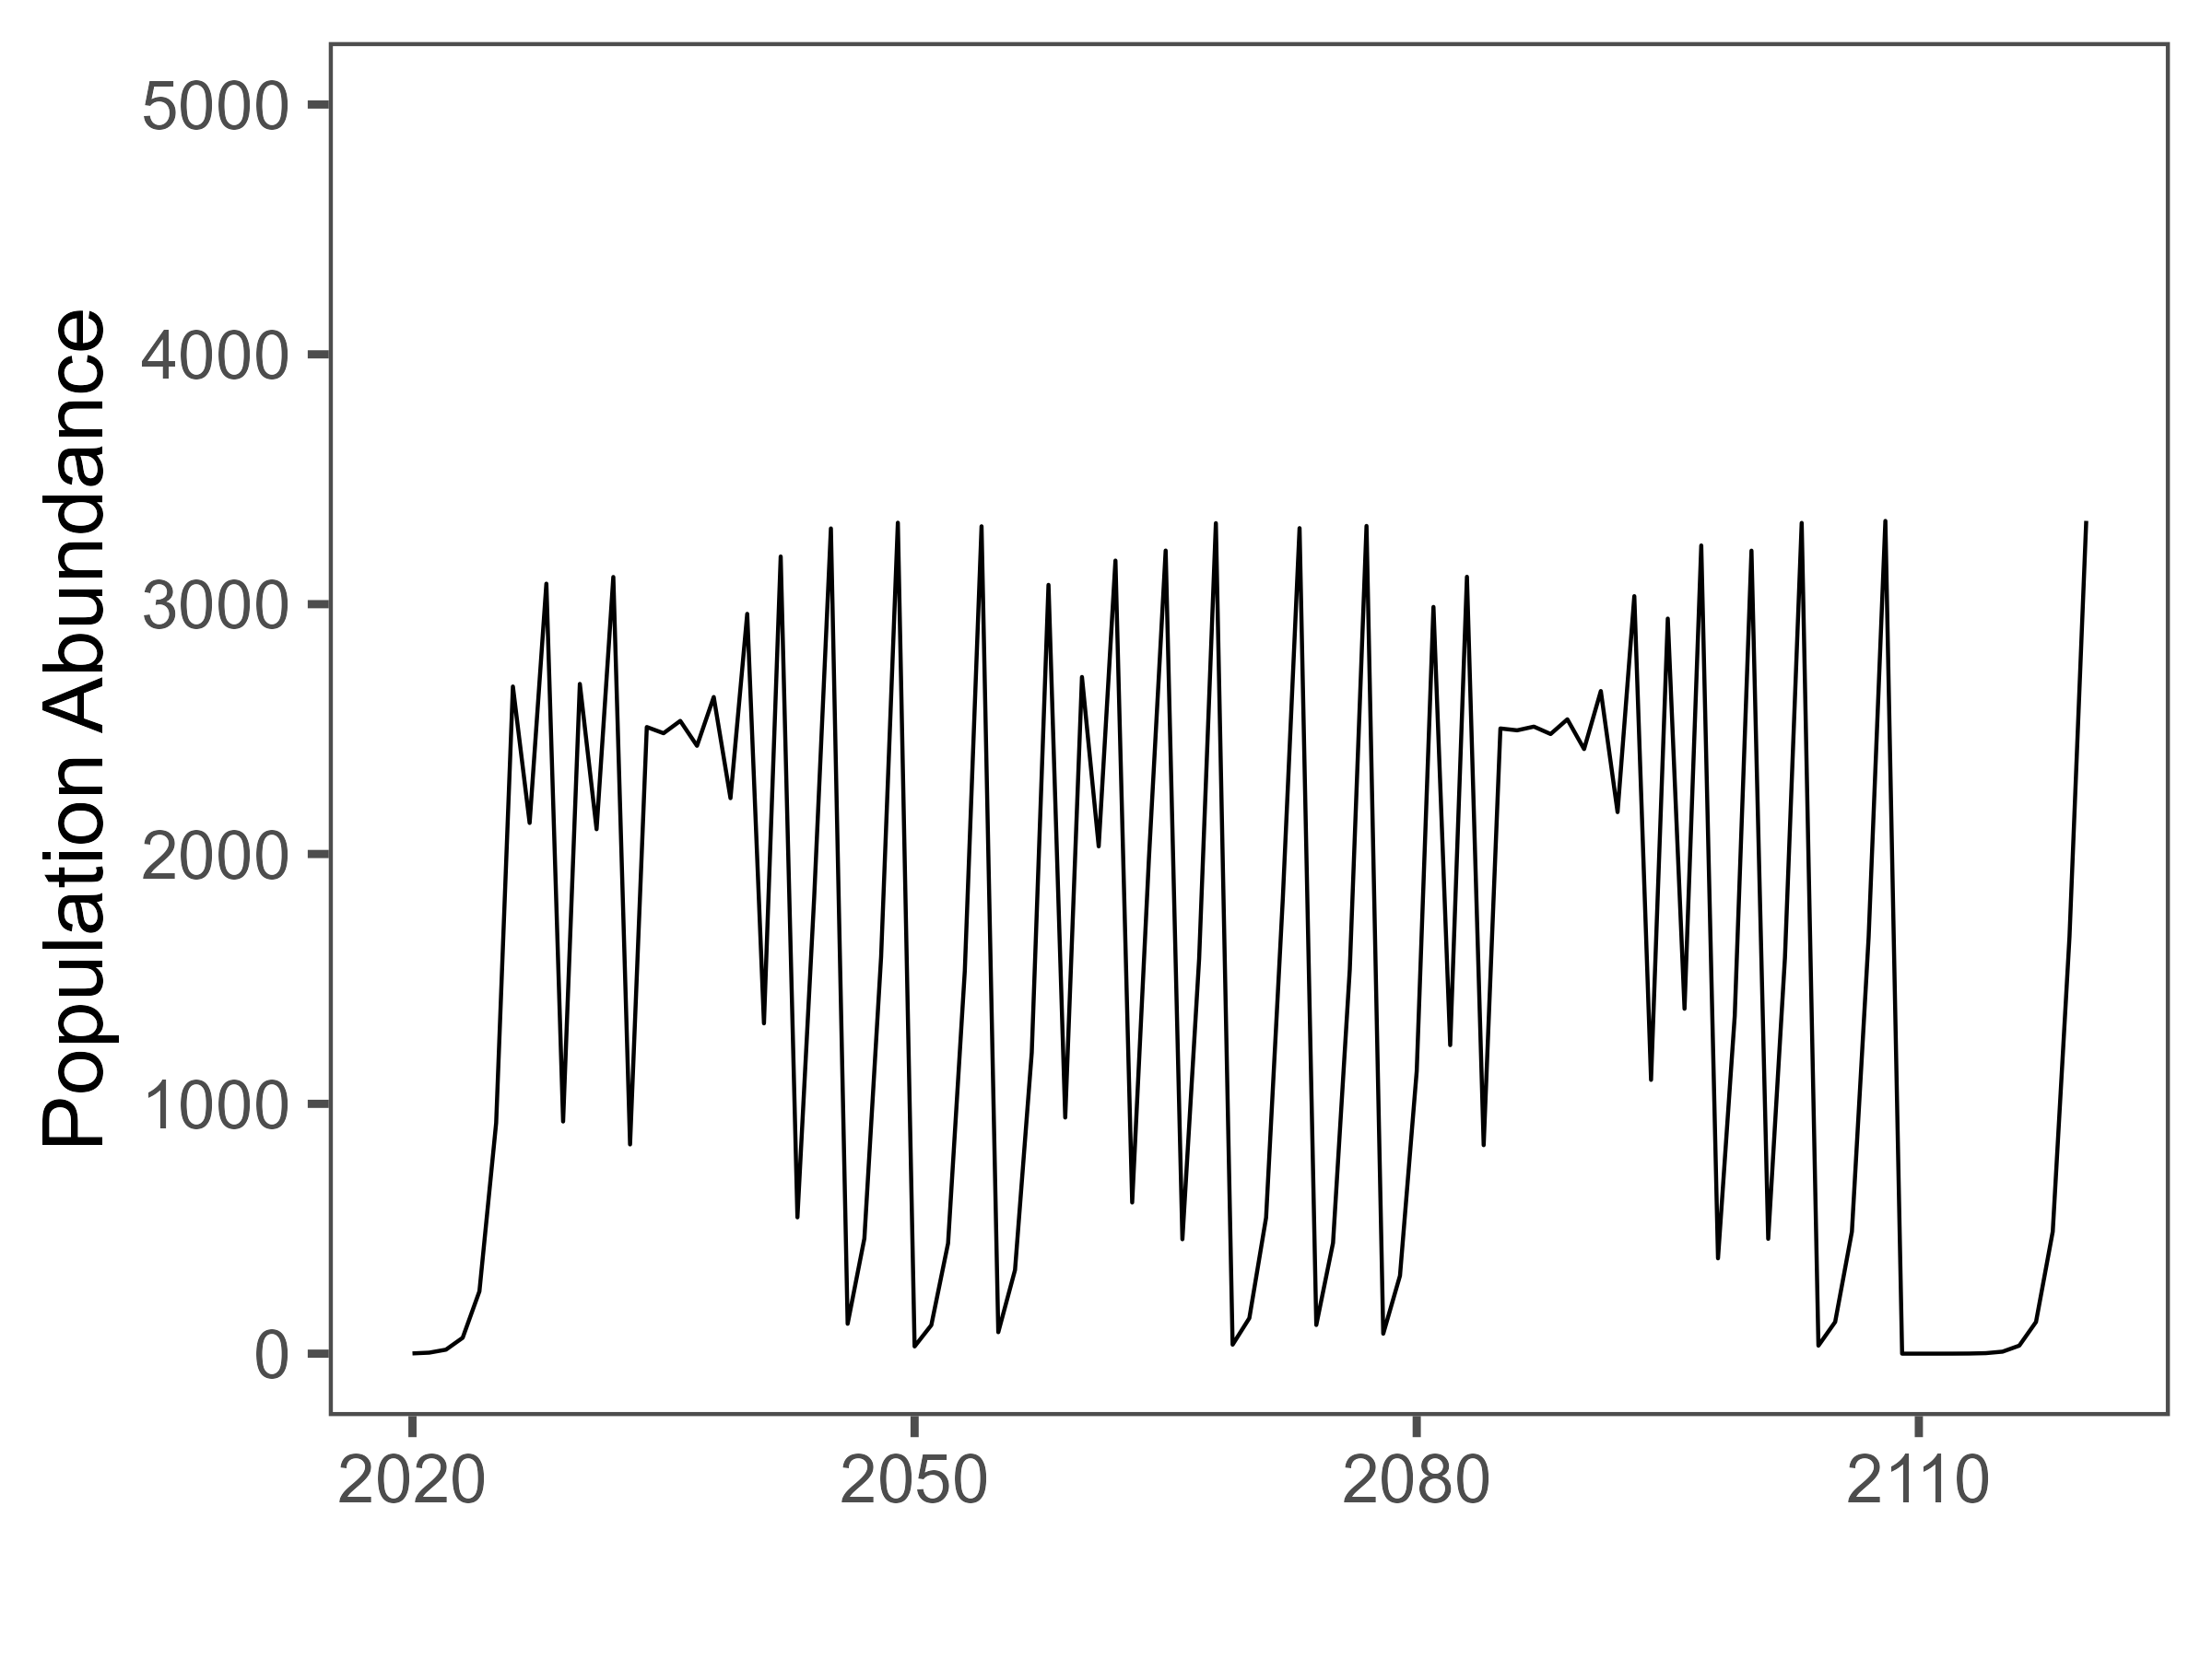
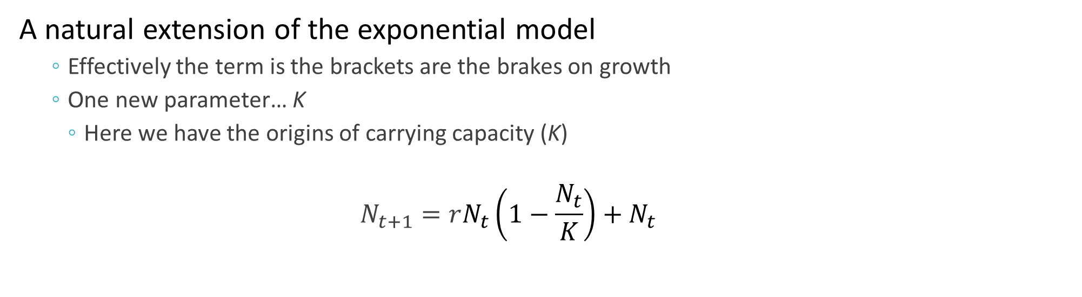
The Logistic Model
A natural extension of the exponential model
Effectively the term is the brackets are the brakes on growth
One new parameter… K
Here we have the origins of carrying capacity (K)
$$N_{t+1}=rN_{t}\left(1−\frac{N_{t}}{K}\right)+N_{t}$$
Notes:
Four lecture topics are identified by red boxes
- People is in bold because there are direct implications of the science on the people that it impacts.

Slide 13
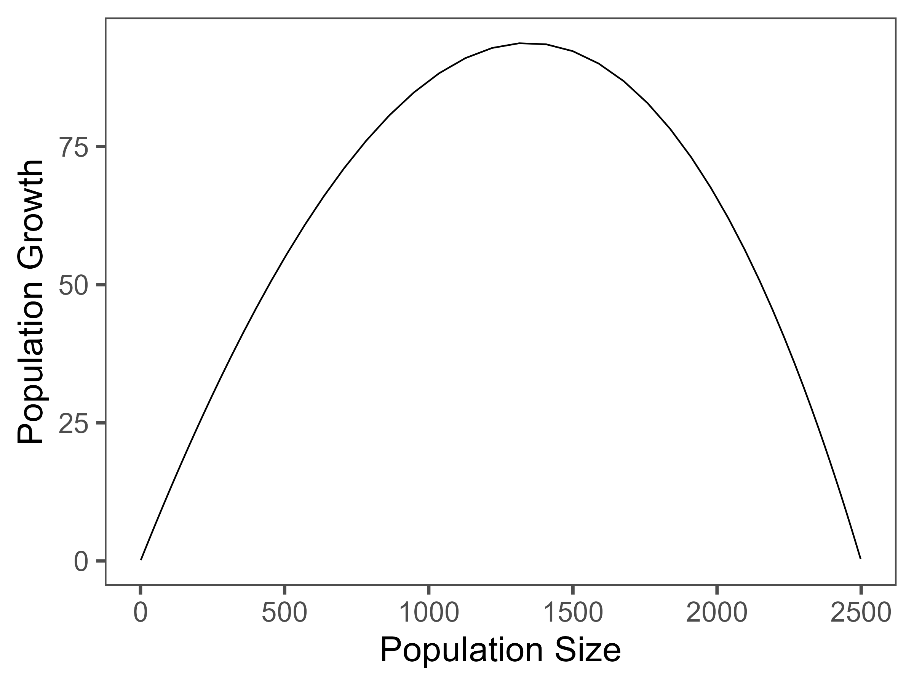
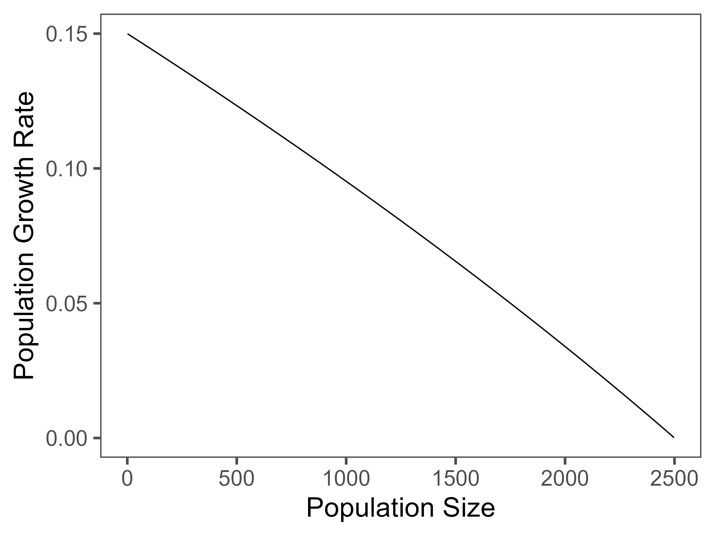
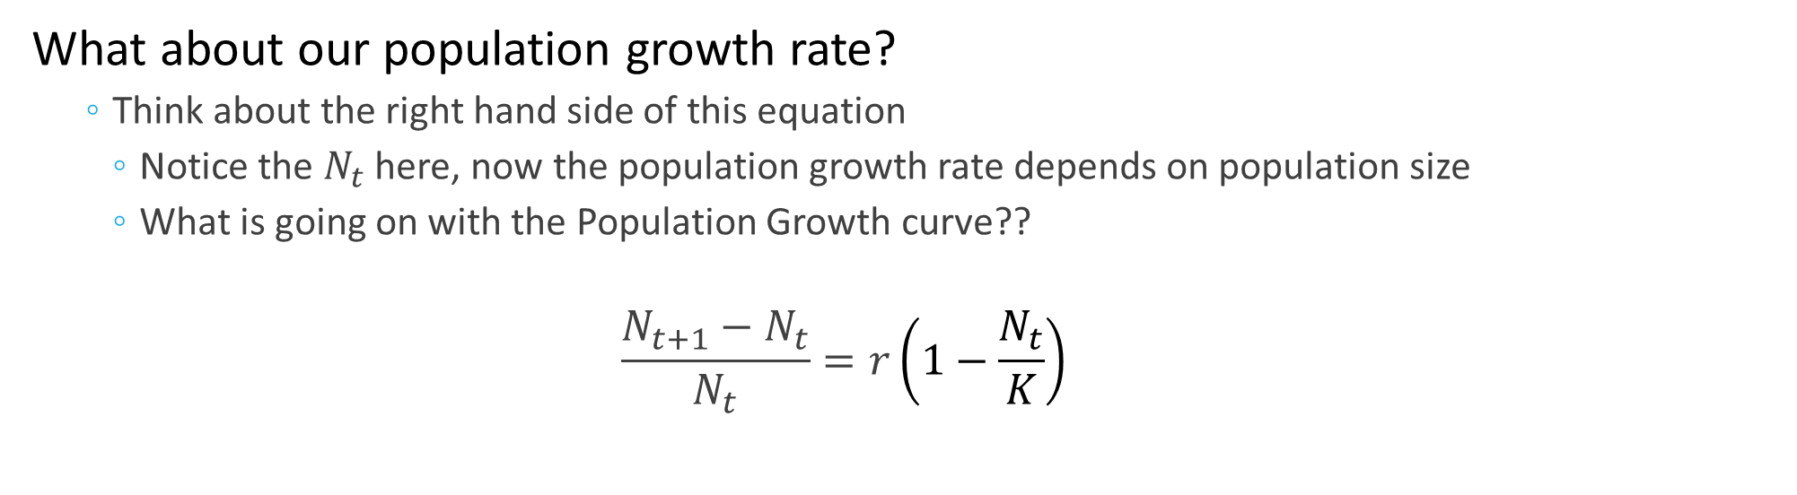
The Logistic Model
What about our population growth rate?
Think about the right hand side of this equation
Notice the $N_{t}$ here, now the population growth rate depends on population size
What is going on with the Population Growth curve??
$$\frac{N_{t+1}−N_{t}}{N_{t}}=r\left(1−\frac{N_{t}}{K}\right)$$
Notes:
Four lecture topics are identified by red boxes
- People is in bold because there are direct implications of the science on the people that it impacts.

Slide 14

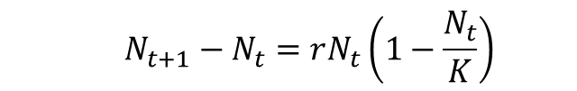
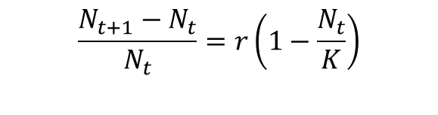
The Logistic Model
Population size vs Population growth rate vs Population Growth
$$\frac{N_{t+1}−N_{t}}{N_{t}}=r\left(1−\frac{N_{t}}{K}\right)$$
$$N_{t+1}−N_{t}=rN_{t}\left(1−\frac{N_{t}}{K}\right)$$
$N_{t+1}=rN_{t}\left(1−\frac{N_{t}}{K}\right)+N_{t}$
Notes:
Four lecture topics are identified by red boxes
- People is in bold because there are direct implications of the science on the people that it impacts.

Slide 15
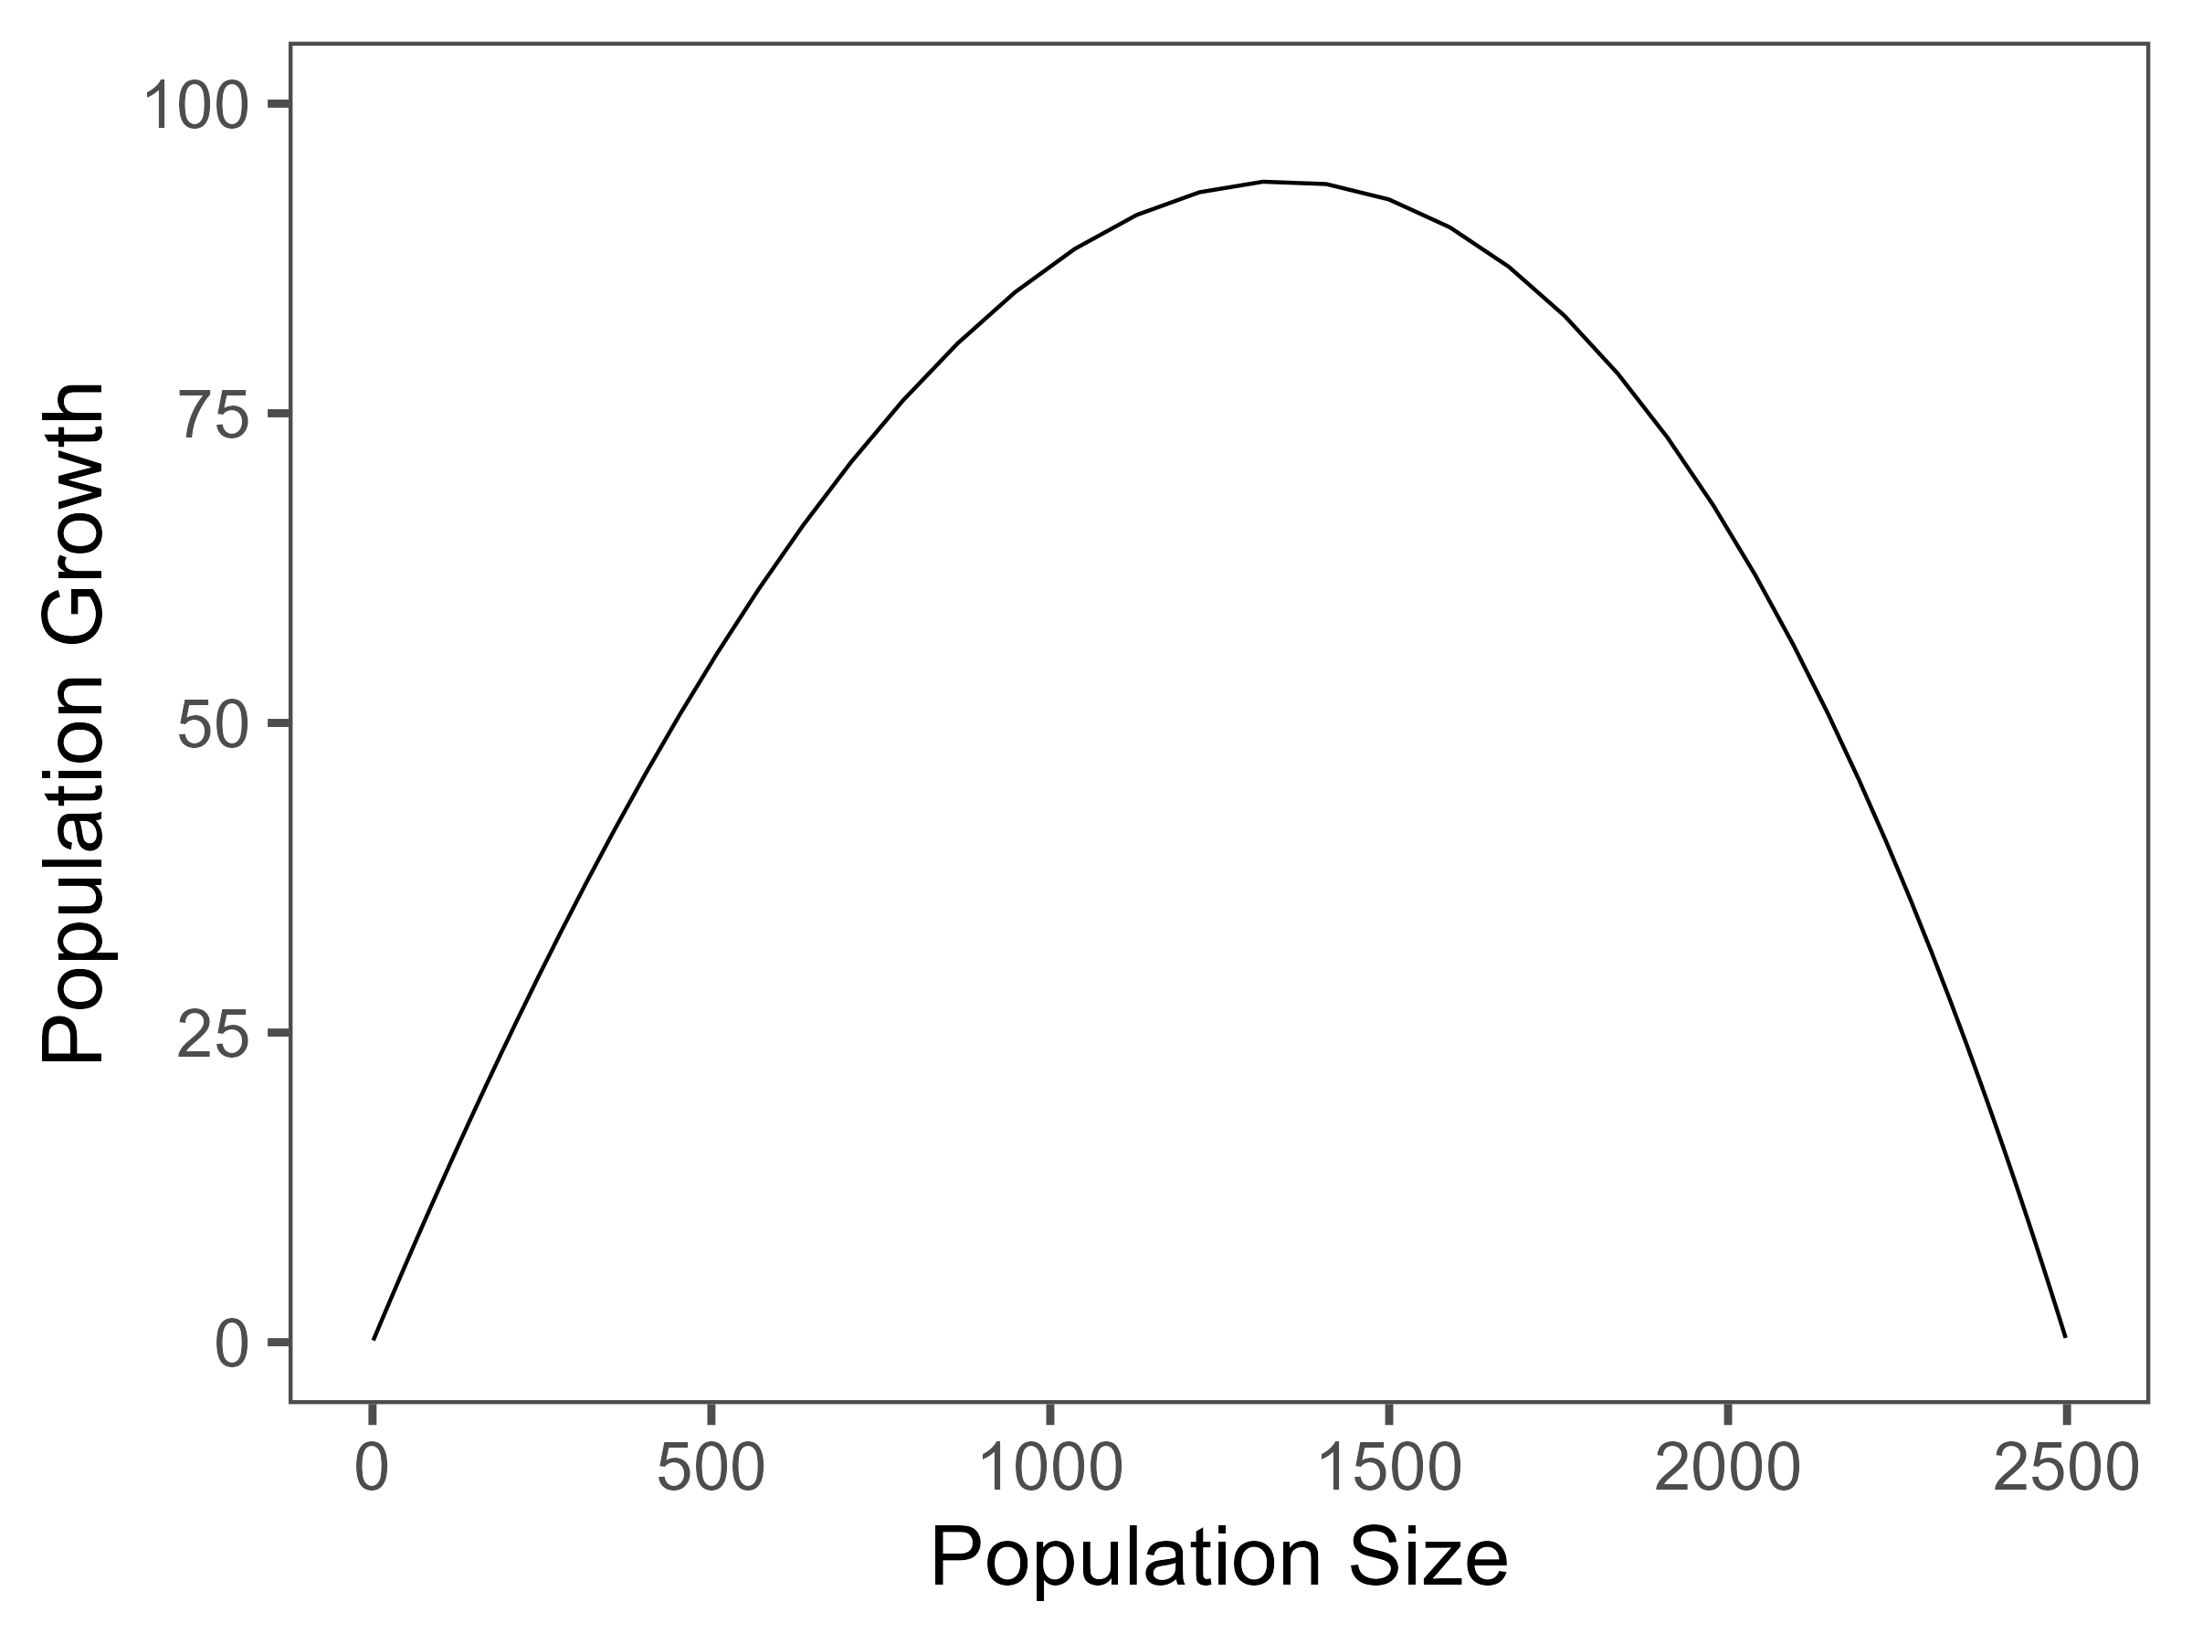
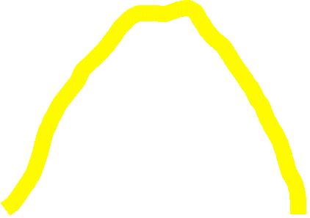

The Logistic Model
Focusing on this population growth curve
What happens if we harvest individuals in this population?
If you harvest this population
Above the curve the population declines
Below the curve the population increases
On the curve population doesn’t change
How would you ‘maximize’ the number harvested?
Declines
Declines
Declines
Increases
$$N_{t+1}=rN_{t}\left(1−\frac{N_{t}}{K}\right)+N_{t} −C_{t}$$
Notes:
Four lecture topics are identified by red boxes
- People is in bold because there are direct implications of the science on the people that it impacts.

Slide 16

The Logistic Model
Why would harvesting at the maximum be poor form?
Harvesting can can never be perfectly controlled
There is always variability in the system
There is uncertainty in the estimate of numbers
Parts of the population will have different growth rates
Population size is not the only influence on population growth
Your model is ALWAYS wrong
Would you implement a harvest based on this concept?
Declines
Declines
Declines
Increases
$$N_{t+1}=rN_{t}\left(1−\frac{N_{t}}{K}\right)+N_{t} −C_{t}$$
Notes:
Four lecture topics are identified by red boxes
- People is in bold because there are direct implications of the science on the people that it impacts.

Slide 17
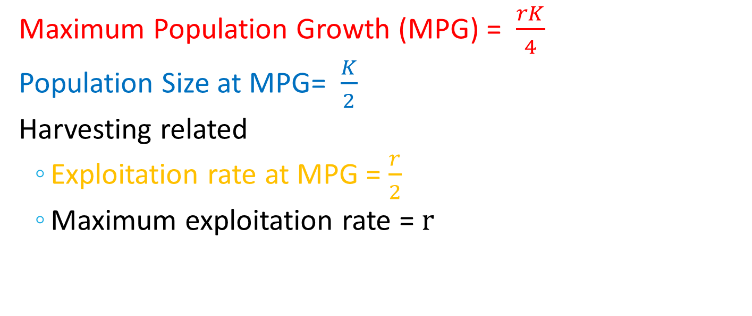
Some fun Logistic Maths
Maximum Population Growth (MPG) = $\frac{rK}{4}$
Population Size at MPG= $\frac{K}{2}$
Harvesting related
Exploitation rate at MPG = $\frac{r}{2}$
Maximum exploitation rate = $r$
Notes:
Four lecture topics are identified by red boxes
- People is in bold because there are direct implications of the science on the people that it impacts.

Slide 18
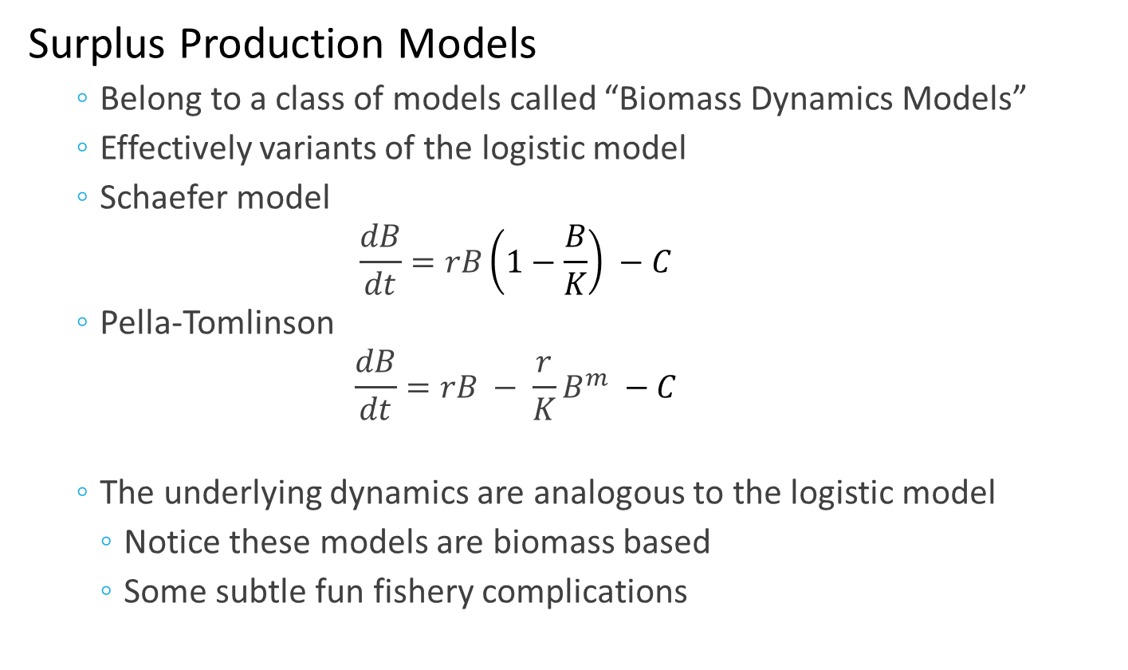
Fisheries Analogies
Surplus Production Models
Belong to a class of models called “Biomass Dynamics Models”
Effectively variants of the logistic model
Schaefer model
$$\frac{dB}{dt}=rB\left(1−\frac{B}{K}\right) −C$$
Pella-Tomlinson
$$\frac{dB}{dt}=rB − \frac{r}{K}B^{m} −C$$
The underlying dynamics are analogous to the logistic model
Notice these models are biomass based
Some subtle fun fishery complications
Surplus Production
Stock Biomass
Notes:
Four lecture topics are identified by red boxes
- People is in bold because there are direct implications of the science on the people that it impacts.

Slide 19
Tutorial
Exploring the Logistic model
This tutorial compares the dynamics of the logistic model in 4 parts
Explore ‘deterministic’ population dynamics
No variability
Explore ‘stochastic’ population dynamics
Allow r (intrinsic rate of growth) to vary over time
Runs a series of simulations to explore variability in population growth
Explore deterministic population dynamics with harvesting
Harvesting a ‘fixed’ quota of animals
Initial example has a harvest set at the Maximum Population Growth (MPG)
You can tweak the harvest ‘quota’ to explore effect on population
Explore ‘stochastic’ population dynamics with harvesting
Combines (3) and (4) to show how variability effects the population when the harvest quota is fixed
Notes:
Four lecture topics are identified by red boxes
- People is in bold because there are direct implications of the science on the people that it impacts.

